Slide 1


PIZZA SALES ANALYSIS
By - Atharva Tiwari
Analysed pizza sales dataset containing more than 48,000 rows of data and prepared an interactive dashboard.
Used tools like SQL, Excel and Excel forecasting to get insights about Pizza Sales and customer behaviour.
Provided a Sales Growth strategy which lead to a 10% increase in pizza sales revenue.

Slide 2
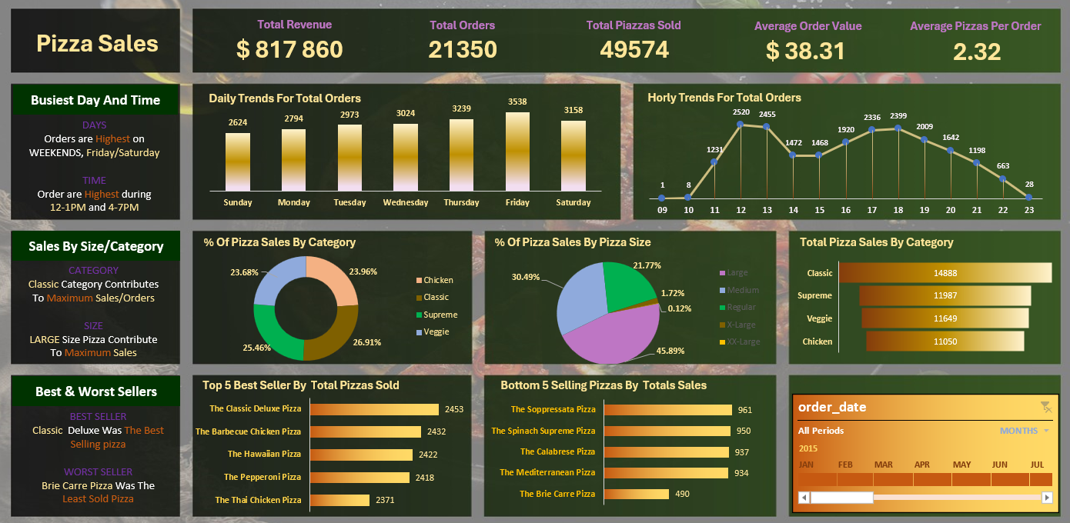
Prepared A Dashboard Through The Pizza Dataset

Slide 3



What is the total Revenue

Slide 4



What is the average order value per user?

Slide 5


How many pizzas were sold?

Slide 6


How many order were placed?

Slide 7



How many order were placed per user?

Slide 8

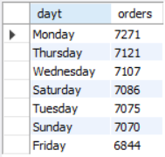
Average pizzas per order

Slide 9
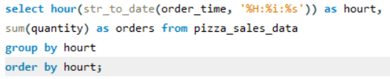
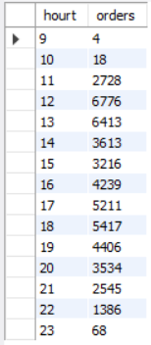
trend with day hour

Slide 10
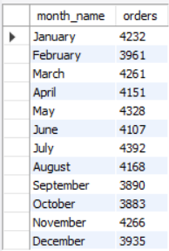
Pizza sales with month

Slide 11
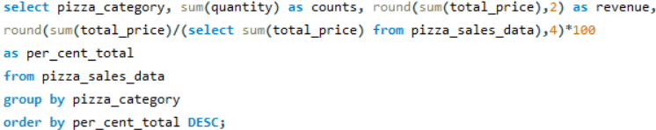
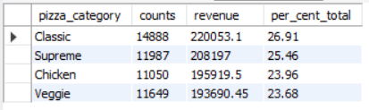
% of pizza sale per category

Slide 12
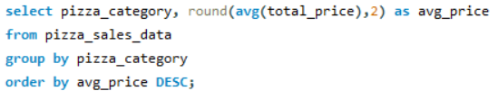
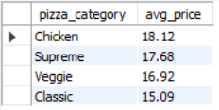
Average price of each pizza category

Slide 13
How many order were placed per user?

Slide 14
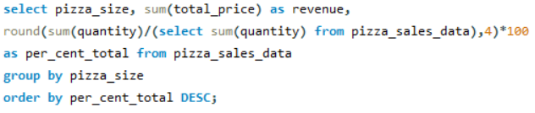
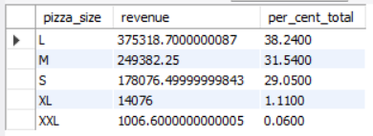
% sales by pizza size

Slide 15

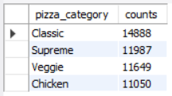
Total pizza sold per category

Slide 16
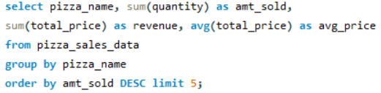
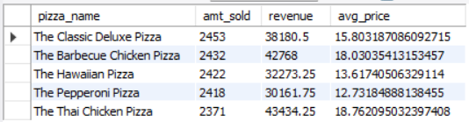
Top 5 best seller pizzas by total pizzas sold

Slide 17
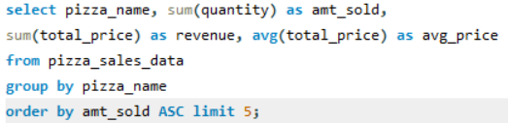
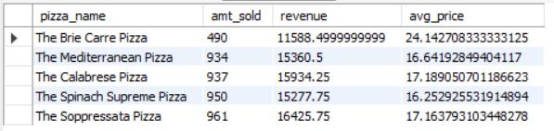
Least 5 sold pizzas by total pizzas sold

Slide 18
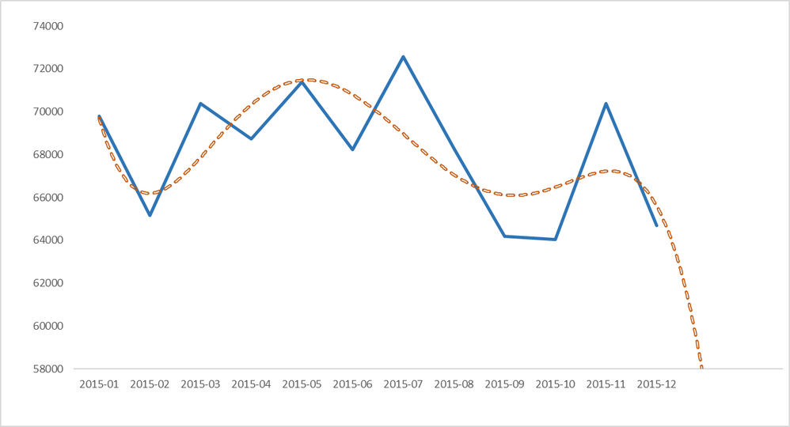

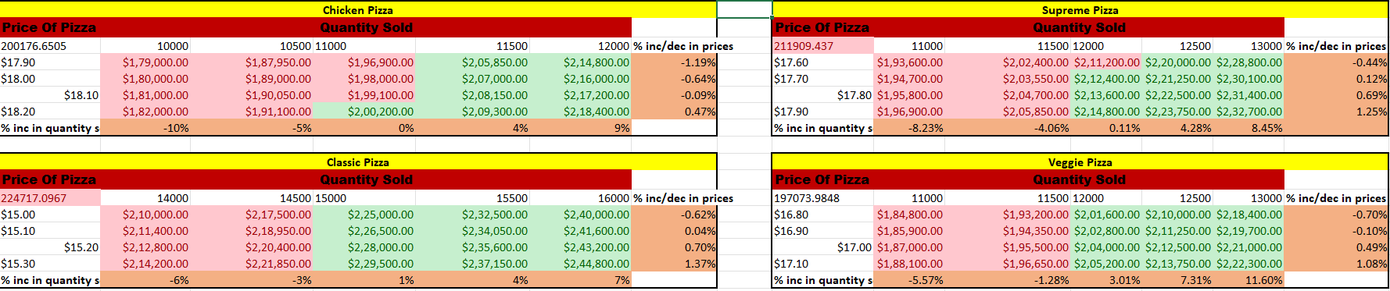
Data forecasting suggests a 10% drop in monthly revenue for next 3 month.
Prices of pizzas and pizza unit sales can be altered generate extra Revenue.
Here the data is analysed by the pizza Category to increase the revenue
Pizza prices can be increased upto 0.5%-1% , as well as pizza unit sales can be increased upto 7% to increase the revenue
Following measures can lead to 11% increase in revenue

